Slide 1


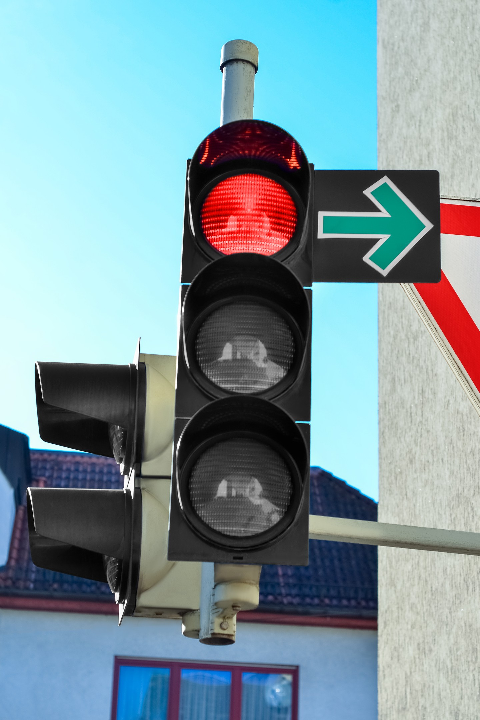

Traffic Light Controller Simulation Using 8086
ASSEMBLY LANGUAGE MINI PROJECT
2125UIDM1080 | 2125UIDM1031 | 2125UIDF1102 | 2125UIDM1116

Slide 2


What is a Traffic Light Controller ?
A traffic light controller is a system that manages road traffic by switching signals in a fixed, timed order so vehicles move safely and smoothly.
This project simulates that behaviour using 8086 assembly language, displaying signal messages on screen one after another in a continuous loop.
RED
YELLOW
GREEN

Slide 3

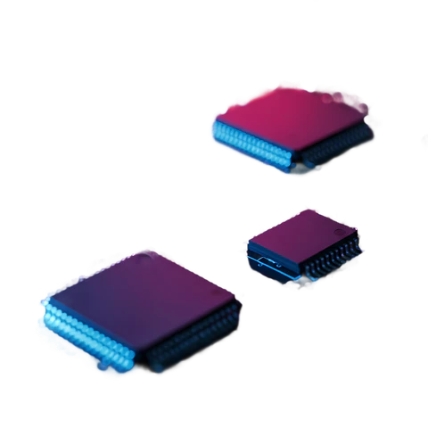


OBJECTIVES
Project Objectives
Understand the basics of 8086 assembly language programming.
Display RED, YELLOW and GREEN messages on the screen.
Implement a time delay between each signal message.
Repeat the sequence until a keyboard key is pressed.

Slide 4

04 — CONTROLLER LOGIC
How the Sequence Works
START
RED + Delay
YELLOW + Delay
GREEN + Delay
Key pressed?
NO → repeat the cycle
Each message is printed using DOS INT 21H, function 09H.
A nested LOOP-based delay routine holds each signal on screen.
INT 16H checks the keyboard; if a key is pressed, the program exits.

Slide 5

06 — CHALLENGES & SOLUTIONS
Problems We Solved
● CHALLENGE
● SOLUTION
Delays ran too fast or froze the emulator.
Tuned nested CX loop counts for balanced timing.
Messages printed with garbage characters.
Terminated every string with '$' for INT 21H.
Infinite loop could not be stopped.
Added a non-blocking key check with INT 16H.

Slide 6

CONCLUSION
Built a working traffic light simulation in 8086 assembly.
Learned DOS interrupts, loops and software delays.
Gained hands-on insight into how real controllers operate at low level.
Thank You!

